Slide 1
Analysis of 2016-17 NHL Player Data
Chris Benzen
Chris Gargano
Jack Weiland

Slide 2
AGENDA
Project Description
Hockey 101
Data Collection & Validation
Data Analysis
Results

Slide 3
PROJECT DESCRIPTION

Slide 4
PROJECTION DESCRIPTION
Using a data set for the 2016-17 NHL Season, we will compare analyze a variety of different measures to identify interesting trends and unique data relationships.
We will have a particular focus on player salaries, and whether higher paid players are really worth their salaries.

Slide 5
HOCKEY 101

Slide 6
HOCKEY 101
ASDFASFSDFSADFASF

Slide 7
DATA COLLECTION & VALIDATION

Slide 8
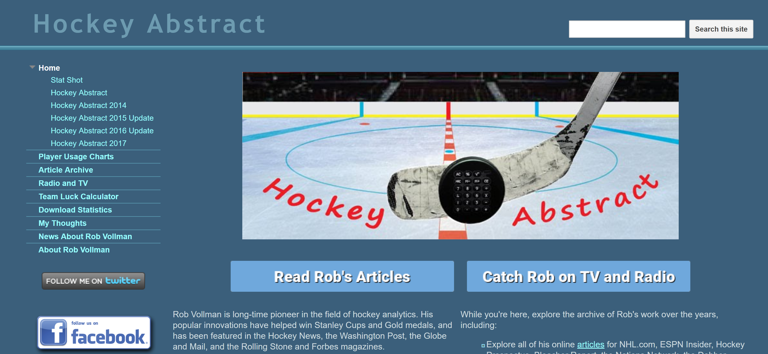
DATA COLLECTION & VALIDATION
We chose to focus on the 2016-2017 season, the last full NHL season
Data was collected from: http://www.hockeyabstract.com/
The source data was compiled from several different sources, including:
NHL.com, Corscia.com, Puckalytics.com, Hockey-reference.com, and more

Slide 9
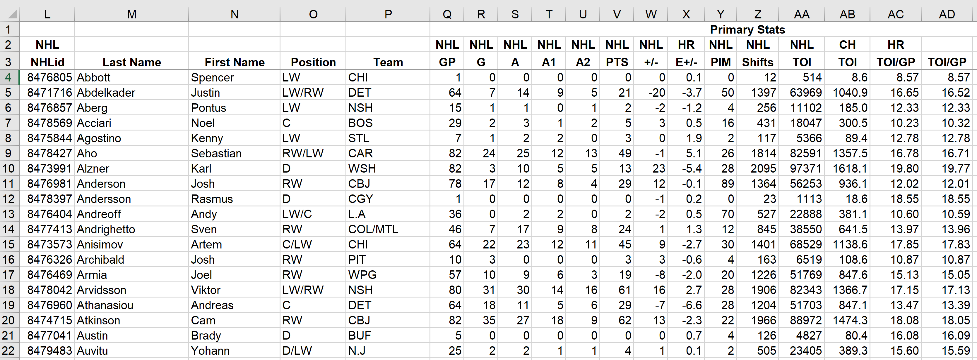
DATA COLLECTION & VALIDATION
Raw data came in Excel format
Number formats were cleaned and NULL values were removed in Excel

Slide 10
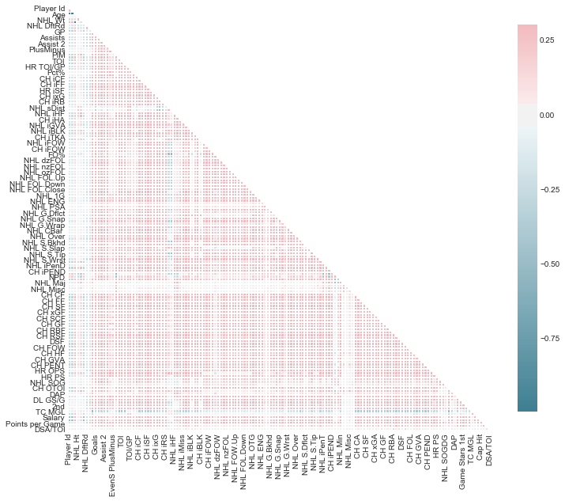
Correlation Matrix
An easy way to identify potential relationships among variables is to analyze their correlations
To do this, we created a correlation matrix
Unfortunately, it did not yield many strong correlations among the raw data

Slide 11
DATA COLLECTION & VALIDATION
Based on the correlation matrix, we decided that we would need to group our data into several different categories such as Nationality, Free Agent Status, Shot Type, and more
For analysis involving player salary data, the data was subset to only include Unrestricted Free Agent (UFA) players
For analysis involving player’s nationality, countries with 5 or fewer active players was grouped into an “OTH” category

Slide 12
DATA ANALYSIS

Slide 13
DATA ANALYSIS
Boxplots:
Cap Hit by Nationality
Draft Round vs. Points Per Game
Bar Charts:
Goals, Shots and Shooting Percentage by Shot Type
Scatterplots:
Cap Hit vs. Points Per Game
Goals For vs. Goals Against by Cap Hit
Donut Charts:
Cap Hit

Slide 14
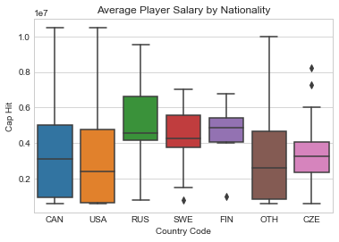
Salary by Nationality
The distribution of salary appears very similar for Canadian and American players
The median salary for Russians, Finns and Swedes is noticeably higher than the cap hits
Russian players had the highest median salary in 2016-17, but this was heavily affected by top earners like Alex Ovechkin ($9.54M) and Evgeni Malkin ($9.5M)
Notes:
Break

Slide 15
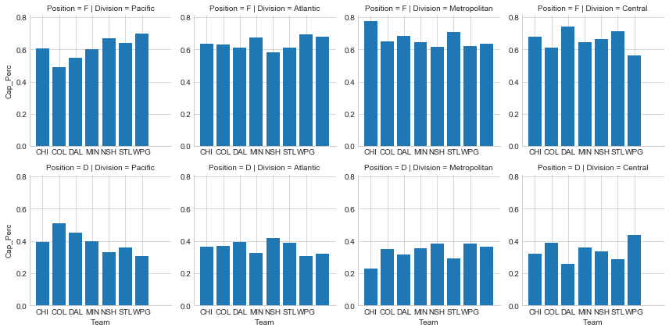
Salary by Position

Slide 16
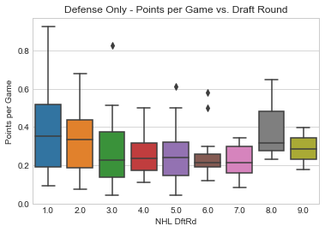
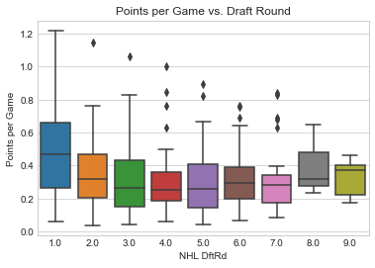
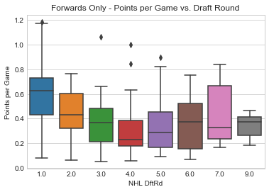
Draft Round vs. Points Per Game
Players drafted in the first round clearly have the highest median salary
After the first round, there are no noticeable difference in median salary

Slide 17
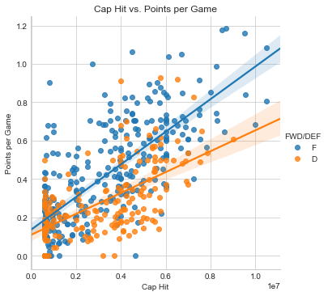
Cap Hit vs. Points per Game
There are clearly, positive linear trends between a player’s cap hit and their PPG.
As expected, forward have a higher average PPG than defensemen
There also appears to be less variability in the PPG vs. Cap Hit relationship among forwards compared to defensemen

Slide 18
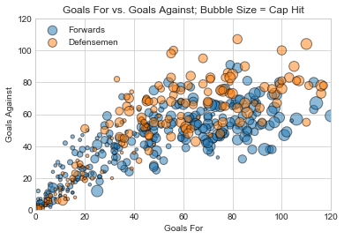
Goals For vs. Goals Against
asdf

Slide 19
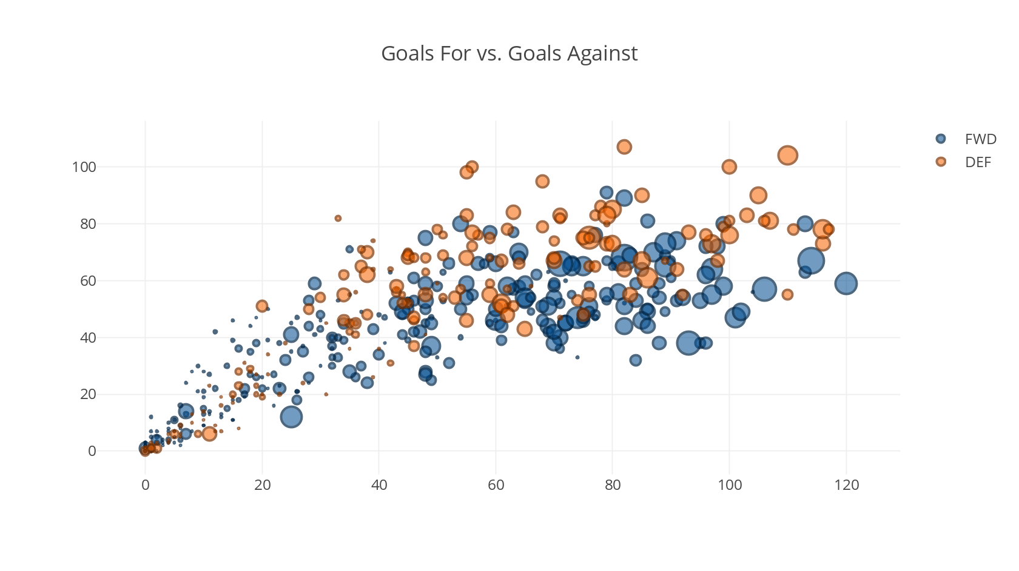
Goals For vs. Goals Against
Same data as the previous slide, but using Plotly

Slide 20
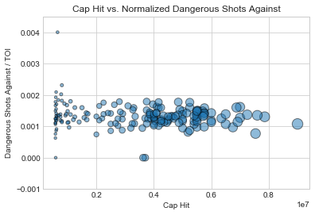
Dangerous Shots Against (D only)
Is there a relationship between team spending on defense and Dangerous Shots Against?

Slide 21
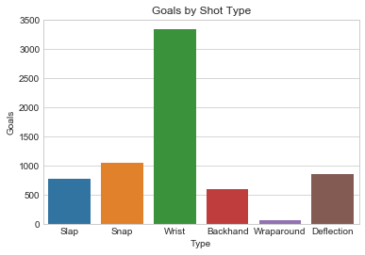
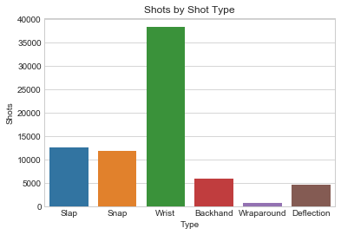
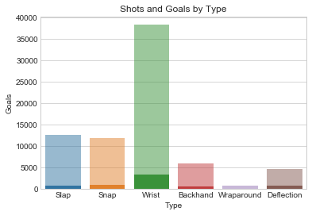
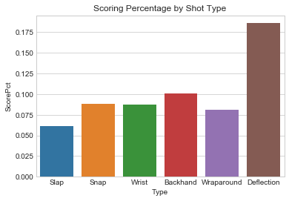
Goal & Shot Analysis
asdf

